Slide 1


Department of CS&E
PROJECT WORK PHASE-3 (18CSP83) PRESENTATION
2021-22
PROJECT TOPIC: “LOW LIGHT IMAGE ENHANCEMENT USING DEEP LEARNING”
PROJECT GROUP ID: 21CS35
Presentation By:
Charish Patel M N 1VE18CS041
Chunith Gowda G S 1VE18CS043
Rashmi S 1VE18CS134
Shirisha K S 1VE18CS146
Guided By:
Mr. Balaji K
Assistant Professor
Dept. of CS&E
SVCE
DEPARTMENT OF COMPUTER SCIENCE AND ENGINEERING
SRI VENKATESHWARA COLLEGE OF ENGINEERING
VIDYANAGAR,BANGALORE-562157

Slide 2
AGENDA
INTRODUCTION
OBJECTIVES
ARCHITECTURE OF THE PROJECT
TESTING
RESULTS
LIMITATIONS
CONCLUSION

Slide 3
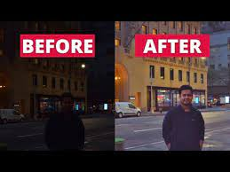
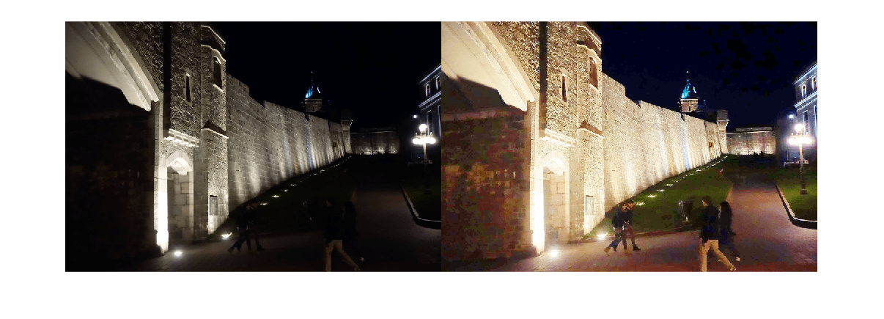
Low Light Image Enhancement Using Deep Learning
INTRODUCTION
Low contrast, poor visibility, and noise characterizes images captured in low-light circumstances. These limitations provide a difficulty to human vision.
Favors high-visibility images, and many intelligent systems that rely on computer vision algorithms, such as all-day autonomous driving and biometric recognition.

Slide 4
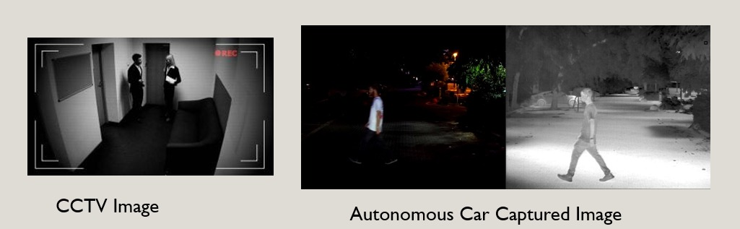
Low Light Image Enhancement Using Deep Learning
OBJECTIVES
To illuminate the images captured in low light conditions.
Minimize the image quality degradation after enhancement.
Coping up with diverse lighting conditions such as non uniform and poor lighting conditions.
To brighten up the image while preserving the inherent color and details.

Slide 5
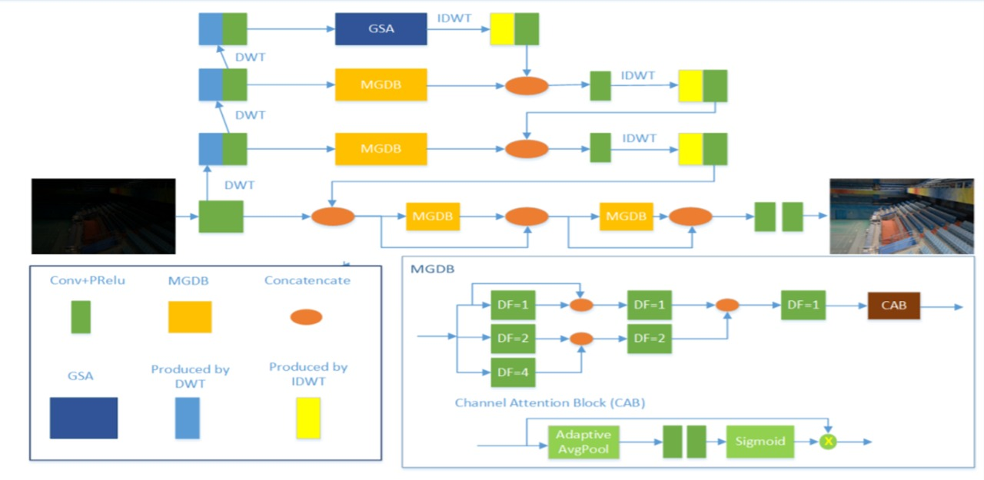
Low Light Image Enhancement Using Deep Learning
ARCHITECTURE OF THE PROJECT

Slide 6
Low Light Image Enhancement Using Deep Learning
TESTING
Data Set
Training Set
Testing Set
Validation Set
Model development
Model
evaluation
Dept of CSE, SVCE

Slide 7
Low Light Image Enhancement Using Deep Learning
We provided experimental results on different datasets to test the proposed system of different image extensions.
Low-Light (LOL) dataset is a publicly available dark-light paired images dataset in the real sense and we used LOL dataset to train the model.
MIT-Adobe FiveK , Dark-Net , UNIQUE were some other datasets which we used for testing the proposed method , these datasets consists of almost 1500 images.
SSIM (Structural similarity), PSNR (Peak signal-to-noise ratio), MSE (mean-square error), FSIM (Feature similarity indexing method) were some metrices to check the accuracy and quality of the images.
Dept of CSE, SVCE

Slide 8
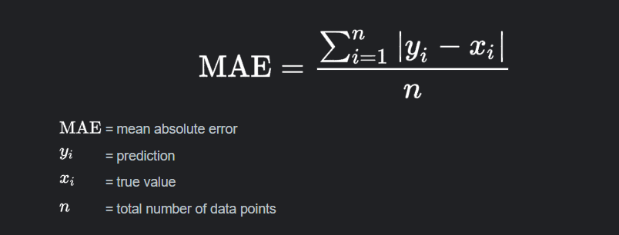
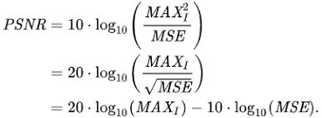
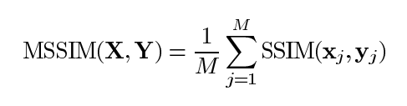
Low Light Image Enhancement Using Deep Learning
LOSS FUNCTION
Objective :The main objective of this module is to test the accuracy of the model.
Input : Both Image input and output is given as input to compare.
Output : The accuracy of the model is known by factors like PSNR , SSIM , MAE .
PyTorch is a python framework and module which can be used to train and test a model at architectural or
Neural layer of the network .
Dept of CSE, SVCE

Slide 9
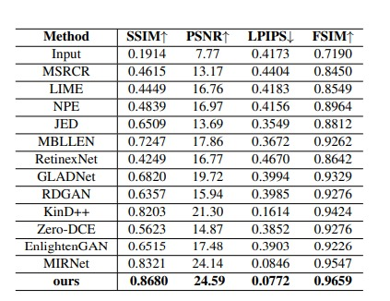
Low Light Image Enhancement Using Deep Learning
Fig : Quantitative comparision of several metric between our method and state-of-the-art methods on LOL dataset.
Dept of CSE, SVCE

Slide 10
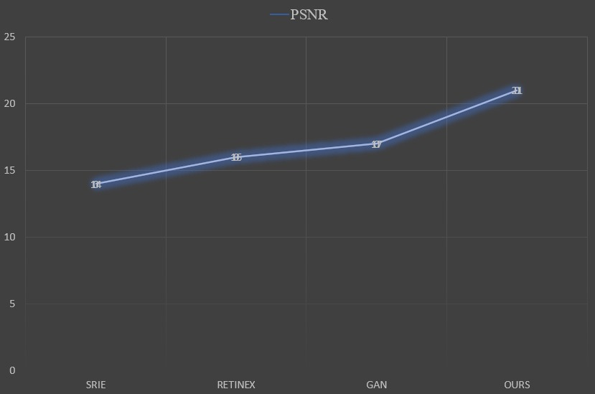
Low Light Image Enhancement Using Deep Learning
Fig : Metrix Comparision of PSNR
Dept of CSE, SVCE

Slide 11
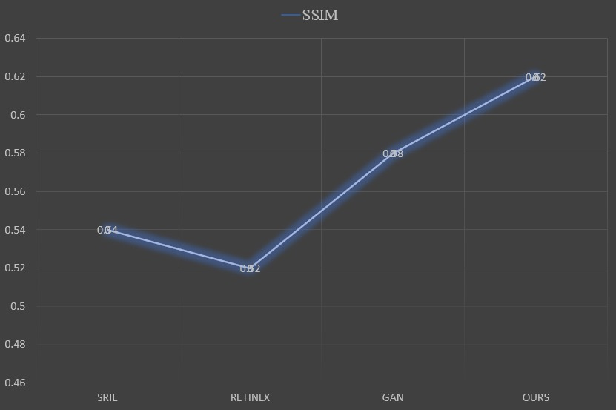
Low Light Image Enhancement Using Deep Learning
Fig : Metrix Comparision of SSIM
Dept of CSE, SVCE

Slide 12
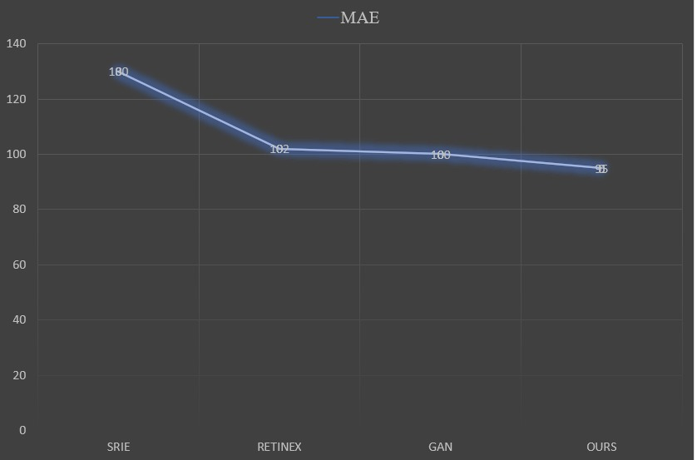
Low Light Image Enhancement Using Deep Learning
Fig : Metrix Comparision of MAE
Dept of CSE, SVCE

Slide 13
Low Light Image Enhancement Using Deep Learning
RESULTS
As a result, the proposed method generalizes well to various lighting.
Every image input given is compressed into 256 * 256 pixels to get desired output.
Our proposed model was found more effective when compared with other baseline image enhancement models.
The metrix were as followed SSIM = 0.8680 , PSNR= 24.59 , LPIPS =0.0772 , FSIM = 0.9659.
Dept of CSE, SVCE

Slide 14
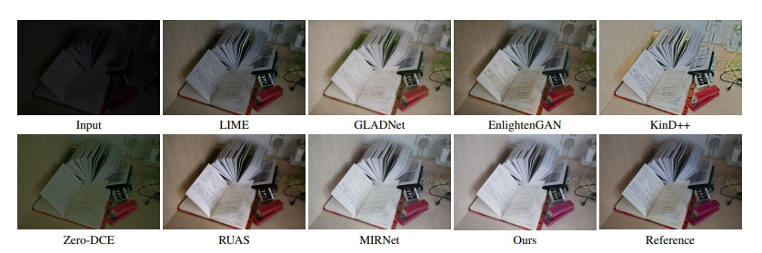
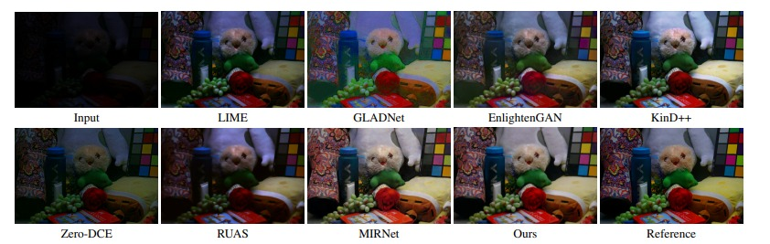
Low Light Image Enhancement Using Deep Learning
Fig : Restoring results of the conventional methods and the proposed method on LOL dataset
Dept of CSE, SVCE

Slide 15
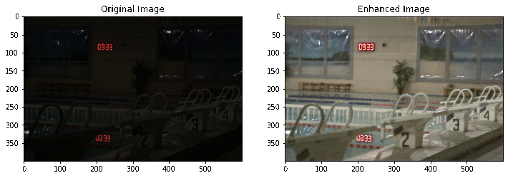
Low Light Image Enhancement Using Deep Learning

Slide 16
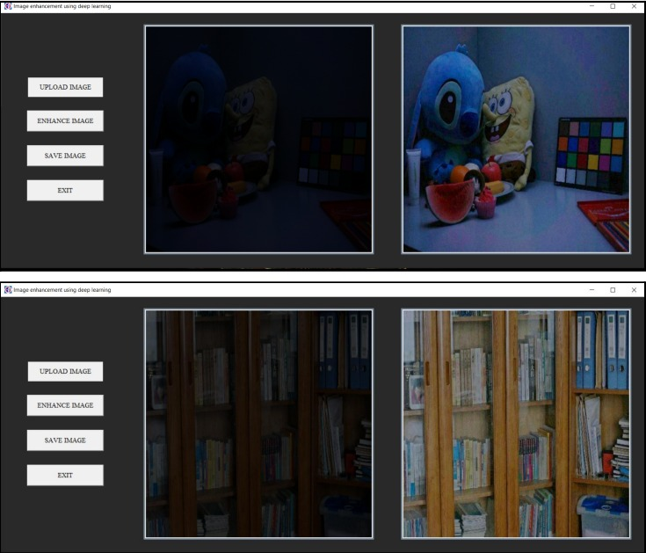
Low Light Image Enhancement Using Deep Learning
Fig : GUI window with input image (left) and output image (right)
Dept of CSE, SVCE

Slide 17
Low Light Image Enhancement Using Deep Learning
LIVE DEMO
Dept of CSE, SVCE

Slide 18
Low Light Image Enhancement Using Deep Learning
LIMITATIONS
Although the image enhancement is efficient enough as per requirements, there are a few cases of usage which could be added for extra features. Some of these limitations of the project are:
The blurred images are not enhanced Properly.
Enhancing is done entirely by machine, the user has no option to control any parameters with respect to image enhancement.
There exists Noise in certain images.
Dept of CSE, SVCE

Slide 19
Low Light Image Enhancement Using Deep Learning
Conclusion
The proposed project serves as a standalone convolutional neural network model for low light image enhancement.
Many real time applications like CCTV surveillance systems, animal detection systems, theft detection systems etc., face the drawback of under performance when used in low light conditions.
The proposed model can be integrated with these real time systems as a preprocessing unit, which leads to the improvement in performance and proper utilization of the potential of the model.
Dept of CSE, SVCE

Slide 20
Low Light Image Enhancement Using Deep Learning
REFERENCES
[1] Chunle Guo1, Chongyi Li1, Jichang Guo1, Chen Change Loy, Junhui Hou, Sam Kwong, Runmin Cong,”Zero-Reference Deep Curve Estimation for Low-Light Image Enhancement”, Beijing Jiaotong University, 22 March 2020.
[2] Gershon Buchsbaum. A spatial processor model for object colour perception. J. Franklin Institute, 2016.
[3] Vladimir Bychkovsky, Sylvain Paris, Eric Chan, and Fredo ´ Durand. Learning photographic global tonal adjustment with a database of input/output image pairs. In CVPR, 2019.
[4] Jianrui Cai, Shuhang Gu, and Lei Zhang. Learning a deep single image contrast enhancer from a multi-exposure image. IEEE Transactions on Image Processing, 2018.
[5] Chen Chen, Qifeng Chen, Jia Xu, and Koltun Vladlen. Learning to see in the dark. In CVPR, 2018.
[6] Yusheng Chen, Yuching Wang, Manhsin Kao, and Yungyu Chuang. Deep photo enhancer: Unpaired learning for image enhancement from photographs with gans. In CVPR, 2018.
[7]DataSet:Darknet:https://www.kaggle.com/peterfriedrich1/darknet-2020-getting-started
Dept of CSE, SVCE

Slide 21
THANK YOU

